Slide 1


Automated Resume Analyzer

Slide 2
PROJECT OVERVIEW
Automated resume analysis system
Extracts skills from resumes
Helps in job screening

Slide 3
OBJECTIVE
Automate resume screening
Extract key skills
Match with job requirements
Generate score

Slide 4
TECHNOLOGIES USED
Python
Streamlit
PyPDF2
Pandas

Slide 5
WORKING PROCESS
Upload Resume
Extract Text
Identify Skills
Match Skills
Generate Score

Slide 6
FEATURES
Resume Upload
Skill Detection
Score Calculation
Graph Visualization
CSV Download

Slide 7
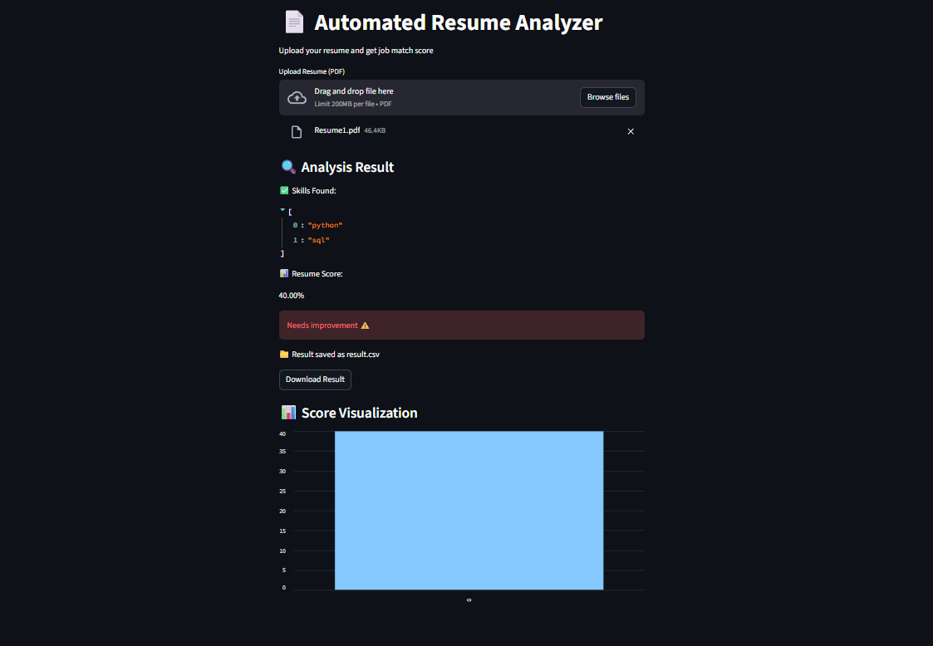
OUTPUT
Display resume score and analysis

Slide 8
CONCLUSION
Reduces manual effort
Fast and efficient
Useful for recruiters

Slide 9
Thank You
Presented by Anshuman,saniya

